Slide 1
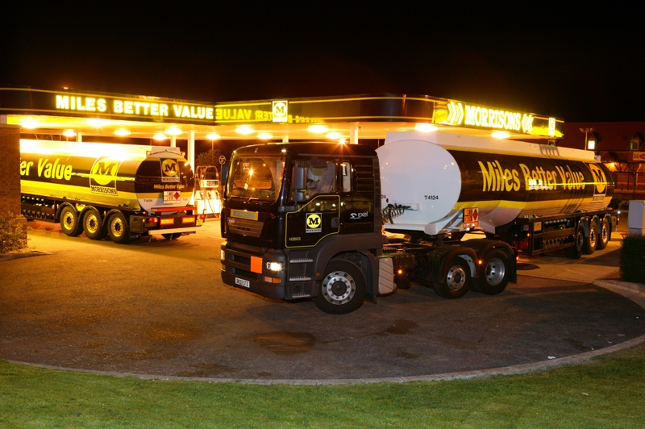
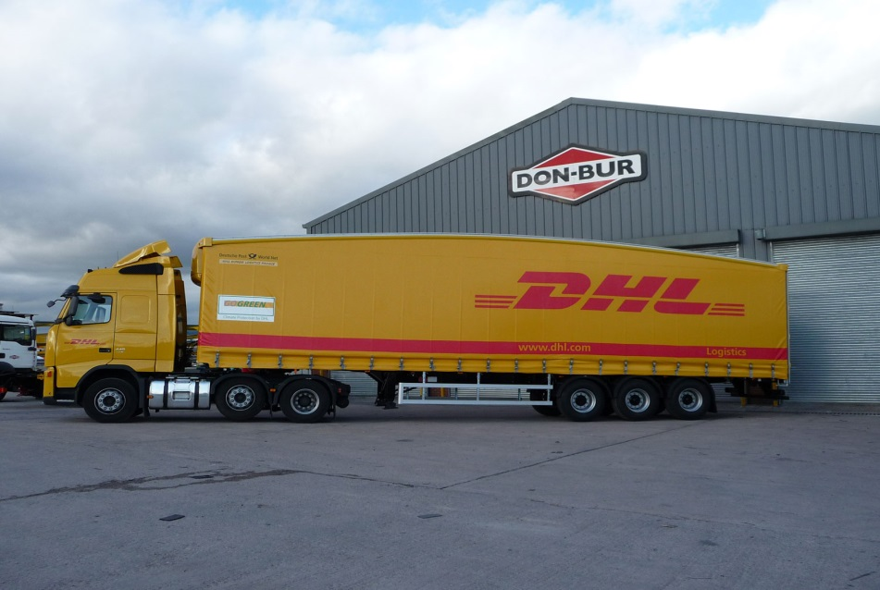
Suitable vehicles for TACS

Slide 2
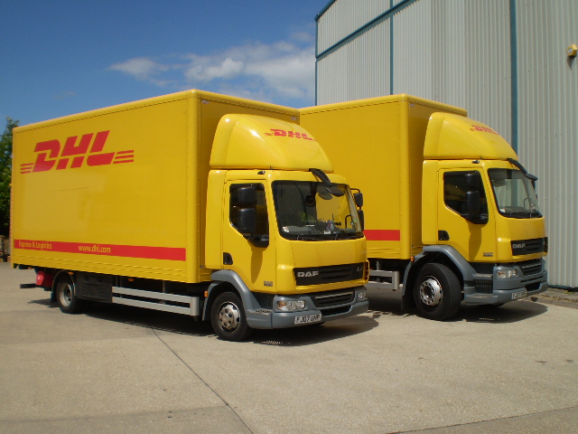
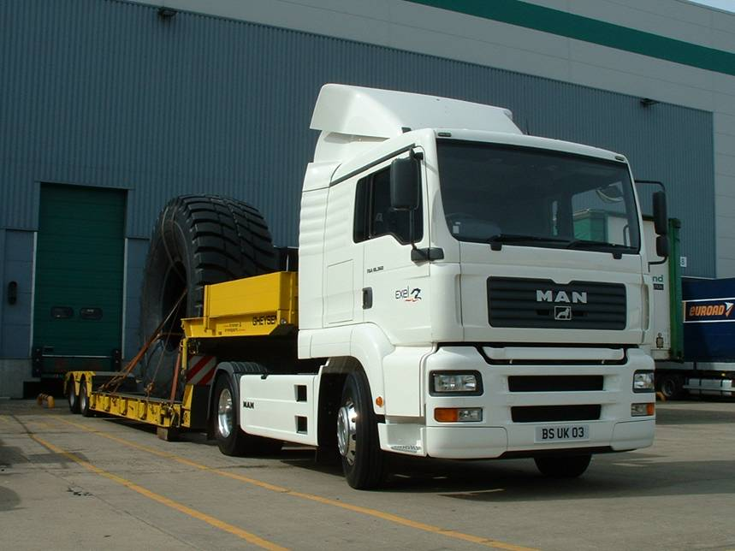
X
4 x 2 Rigid Box
14 tonne (in foreground)
& 18 tonne (in background)
Suitable for rural schools
4x2 Tractor Unit with Sleeper cab carrying a low loader trailer – carries plant machinery
40 tonne
X
Key
4x2 = 4 wheels at the back driving x 2 wheels at the front steering

Slide 3
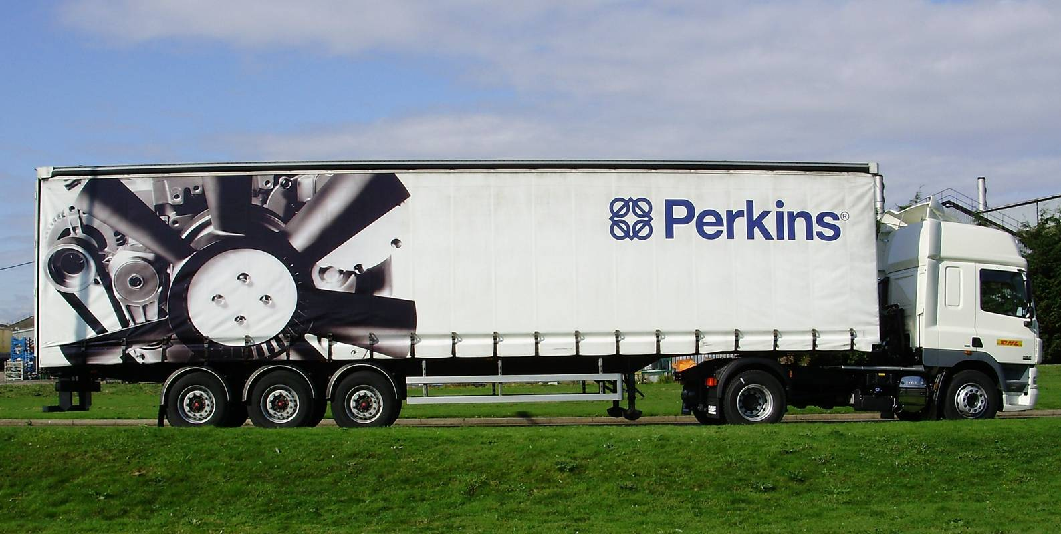
4x2 Tractor 13.6 Tri axle curtain sided trailer also known as a semi trailer. The whole combination is known as an articulated vehicle
40 tonne

Slide 4
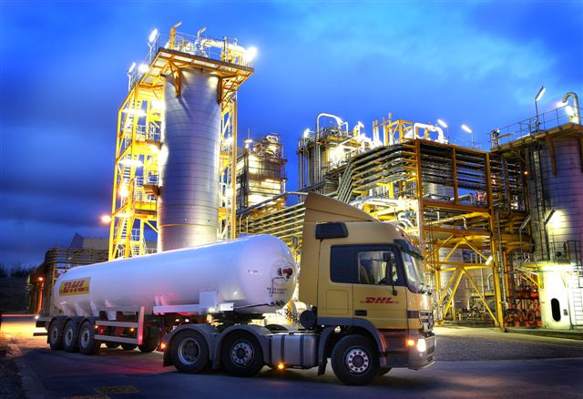
6x2 tractor unit with 13.6 mtr tri axle tank trailer
44 tonne
6x2 tractor unit with 13.6 tri axle fuel tank trailer
44 tonne

Slide 5
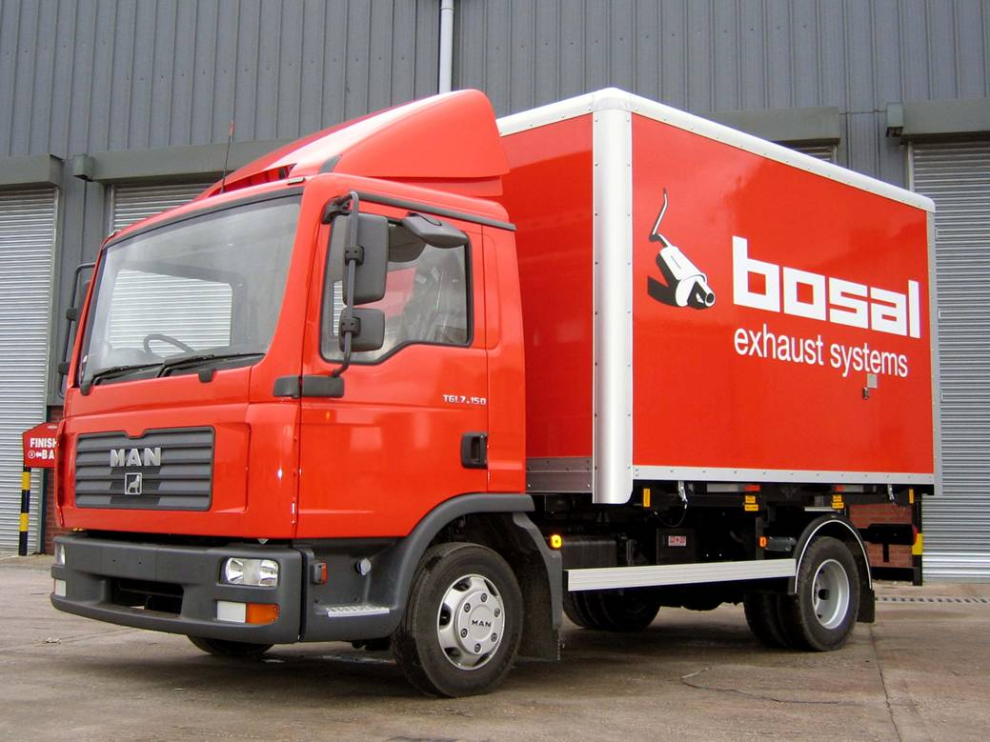
X
7.5 tonne rigid with demount box

Slide 6
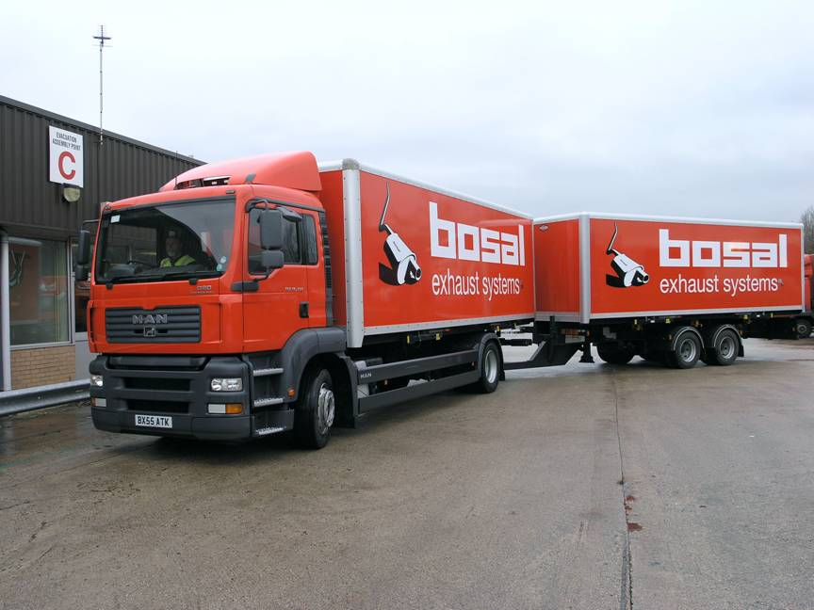
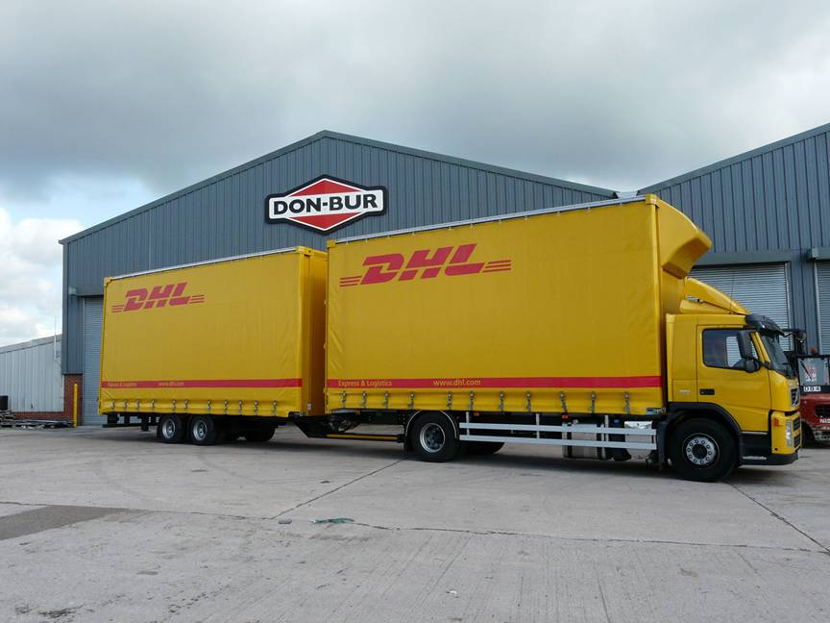
18 tonne prime mover with tandem central axle drawer bar trailer also 18 tonne. Also known as wagon and drag. This is the longest combo units allowed on UK roads.
36 tonne total

Slide 7
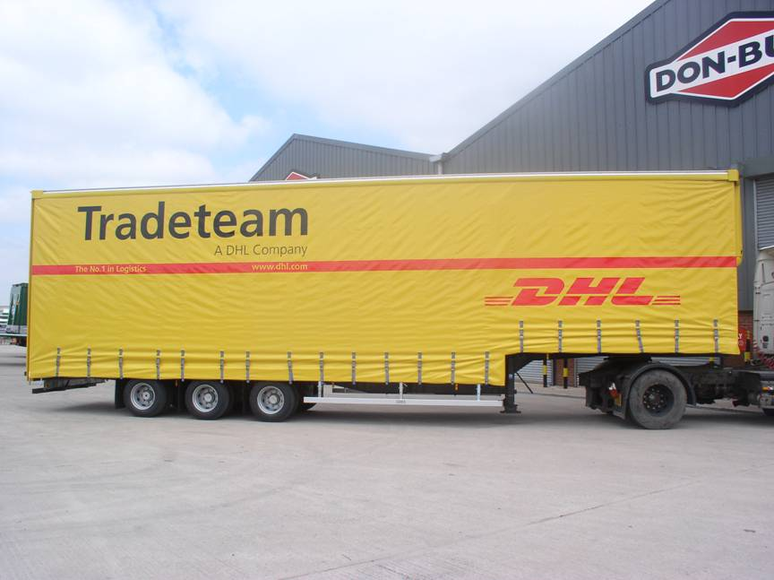
Curtainsider Double Decker
40 tonne (can go up 44 tonne)
Teardrop Curtainsider
44 tonne

Slide 8
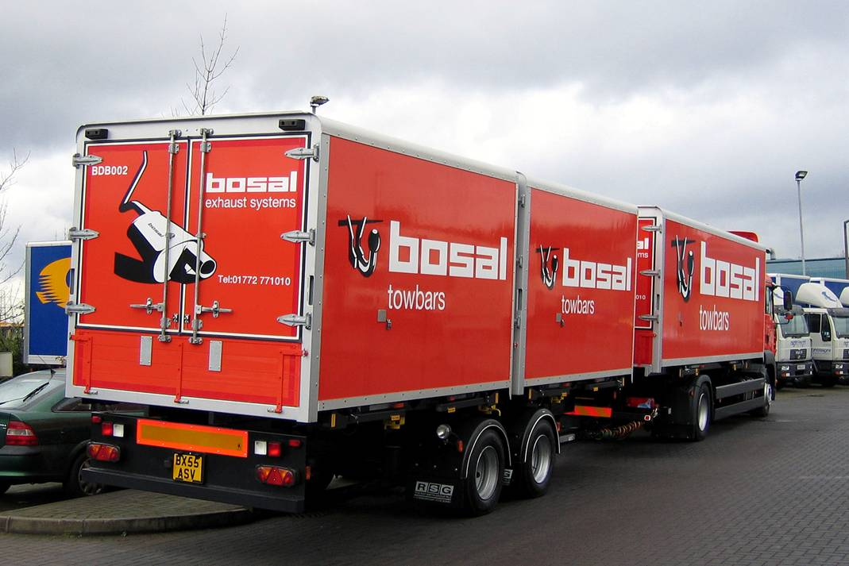
X
Demount box 2 on the trailer one on the vehicle
36 tonne overall combination

